Slide 1

Sprocket Central Pty Ltd
Data analytics approach
AbdEl-Rhman Ashraf Mohamad

Slide 2
Agenda
Introduction
Data Exploration
Model Development
Interpretation

Slide 3
Introduction
Identifying the most valuable customers.
Problem Outline:
Sprocket Central Pty Ltd is a bike and cycling accessories company and a KPMG client.
The marketing team wants to boost business by analyzing their existing customer dataset to determine customer trends and behaviors.
The marketing team want to know which of the 1000 new customers are the most valuable for their business.

Slide 4
Data Exploration
Data Quality Issues and Recommendations
Quality Issues:
Transactions sheet:
Missing values in six columns.
Wrong data type for some columns.
Customer Demographic sheet:
Missing values in several columns.
Invalid date of birth and default values.
Wrong data type for some columns.
Customer Address sheet:
Inconsistent state names.
Recommendations:
Ensure data synchronization.
Enforce drop-down lists.
Apply data type constraints.

Slide 5
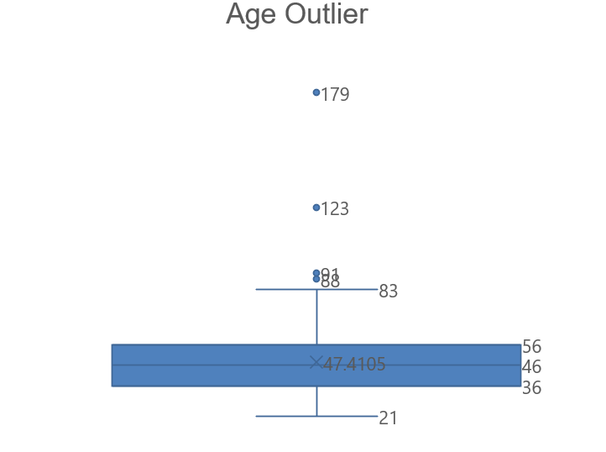
Data Exploration
Statistical Analysis
Outliers:
By applying the IQR to age values, people older than 83.5 have been removed as outliers.
Q1 | 36
Q2 | 55
IQR | 19
Lower Limit | 7.5
Upper Limit | 83.5

Slide 6
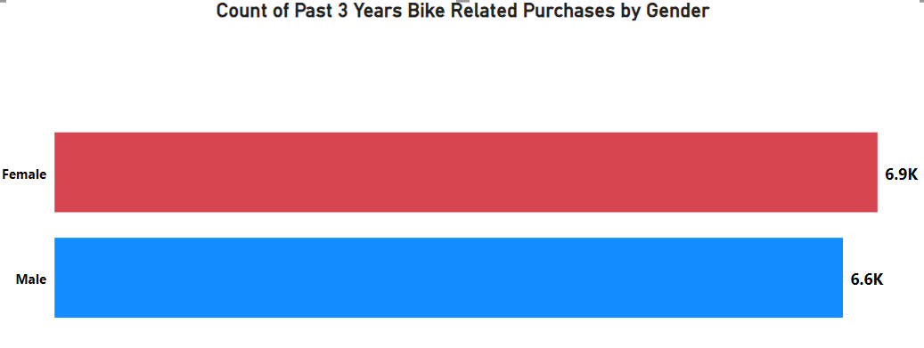
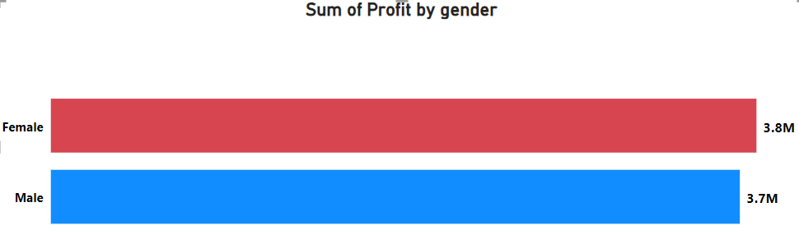
Data Exploration
Past 3 Years Bike Related Purchases By Gender
Females Made slightly more bike related purchases (6.9M) in the last 3 years than Men.
Female made slightly more profit (3.8M) than Men.

Slide 7
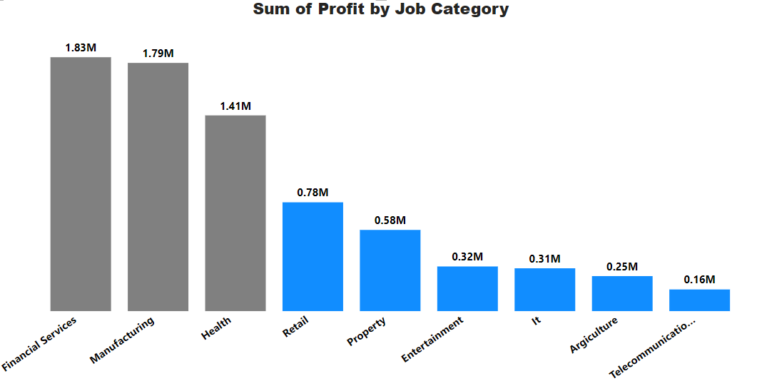
Data Exploration
Top 3 Profitable Industry Category
The most profitable job category are:
Financial Services
Manufacturing
Health
Representing 68% of total profit combined.

Slide 8
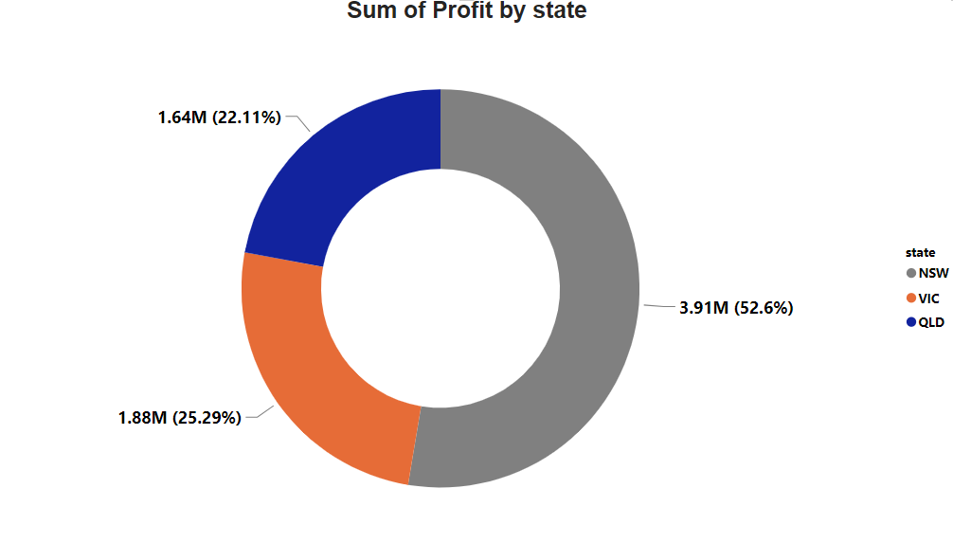
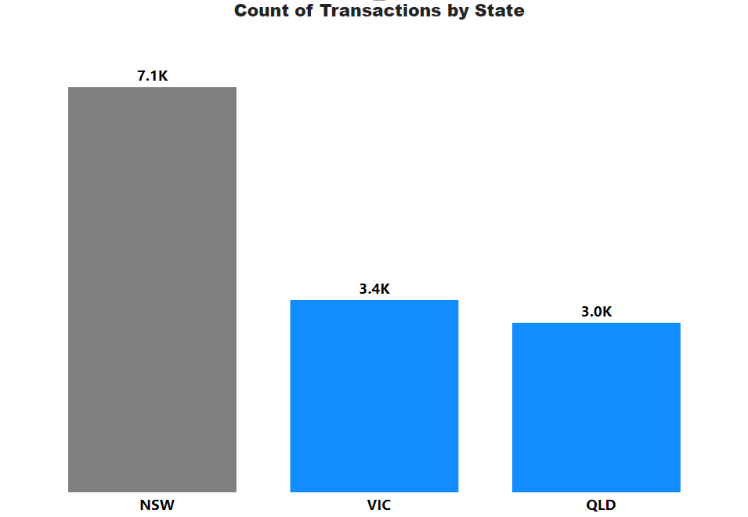
Data Exploration
Most Profitable State
The most profitable state is NSW, with a total number of transaction 7.1K and total profit 3.91M (52.6%)

Slide 9
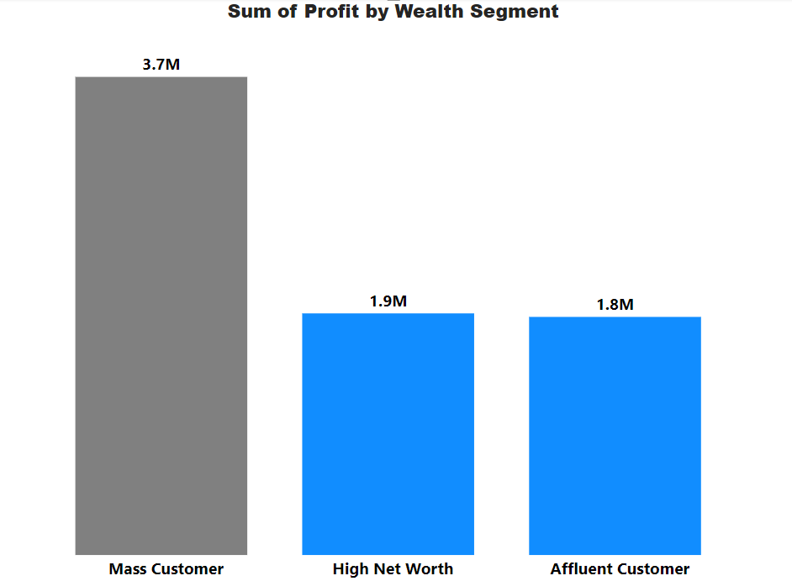
Data Exploration
Most Profitable Wealth Segment
The wealth segment is a categorical variable that divides the customers into three groups: Mass Customer, High Net Worth, and Affluent Customer
The most profitable wealth segment is Mass Customer.
People who are considered as mass customer has the highest sum of profit (3.7M).

Slide 10
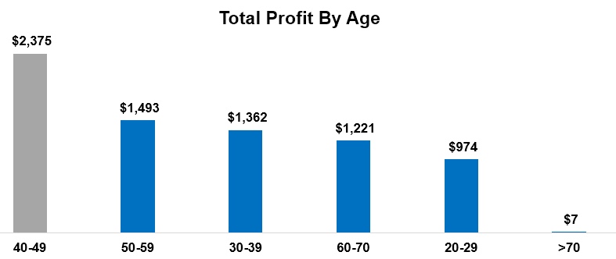
Data Exploration
Most Profitable Age Segment
The most profitable age segment is 40-49 age group has the highest total profit ($2,375).

Slide 11
Interpretation
Key Findings From The Customer Data Analysis
High value customers who should be targeted from the new customer list:
Despite Females are slightly more profitable than males, both gender should be targeted.
Customers in the Financial Services, Manufacturing, and Health sectors.
Customers who live in NSW state.
Mass Customer is the most profitable wealth segment.
Customers aged between 40-49.

Slide 12
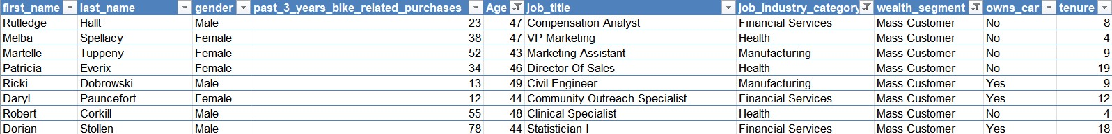
Interpretation
Summary Table For High Value Customers
Example of the most valuable new customers.

Slide 13
Thank You

